Slide 1
CSE 474 Software Design and Architecture
Lecturer Rabia Khan

Slide 2
Topics Covered
Coupling Pattern
Cohesion Pattern

Slide 3
Low Coupling

Slide 4
Coupling
Coupling is a measure of how strongly one element is connected to, has knowledge of, or depends on other elements.
If there is coupling or dependency, then when the depended-upon element changes, the dependant may be affected.
Low Coupling is a desirable property of design because:
  Changes in related classes force local changes.
  Harder to understand in isolation; need to understand other classes.
  Harder to reuse because it requires additional presence of other classes.

Slide 5
Low Coupling Pattern
Name: | Low Coupling
Problem: | How to reduce the impact of change?
Solution: (advice) | Assign responsibilities so that (unnecessary) coupling remains low. Use this principle to evaluate alternatives.

Slide 6
Coupling in OO languages
TypeX has an attribute that refers to a TypeY instance, or TypeY itself.
A TypeX object calls on services of a TypeY object.
TypeX has a method that references an instance of TypeY, or TypeY itself, by any means. These typically include a parameter or local variable of type TypeY, or the object returned from a message being an instance of TypeY.
TypeX is a direct or indirect subclass of TypeY.
TypeY is an interface, and TypeX implements that interface.

Slide 7
Common Forms of Coupling
Low Coupling is an evaluative principle that is applied while evaluating design decisions.
Common forms of coupling from TypeX to TypeY include:
  TypeX has an attribute that refers to a TypeY object.
      class Car {
      private Person owner;
      …
      }
  A TypeX object calls on services of a TypeY object.
      class Application {
      public void start() {
      (new Game()).initialize();
      }
      }

Slide 8
  TypeX has a method that references a TypeY object. For example, as a parameter or local variable or the object returned from a message sent to a TypeY object.
      class Game {
      …
      public void addPlayer(Person p) {
      …
      }
      }
  TypeX is a direct or indirect subclass of TypeY.
      class MyApplet extends JApplet {
      …
      }

Slide 9
  TypeY is an interface, and TypeX implements that interface.
      class Game extends JApplet implements ActionListener {
      …
      }

Slide 10
Coupling
A subclass is strongly coupled to its superclass.
Consider carefully any decision to derive from a superclass since it is such a strong form of coupling.

Slide 11
Low Coupling
Low Coupling supports the design of classes that are more independent, which reduces the impact of change.
It can't be considered in isolation from other patterns such as Expert and High Cohesion,
Rather needs to be included as one of several design principles that influence a choice in assigning a responsibility.

Slide 12
A Practical Example
A good example of a system that has high cohesion and low coupling is the electric subsystem of a house. Because it is made out of a set of appliances with clearly definable function and interconnected with wires, the system has low coupling..

Slide 13
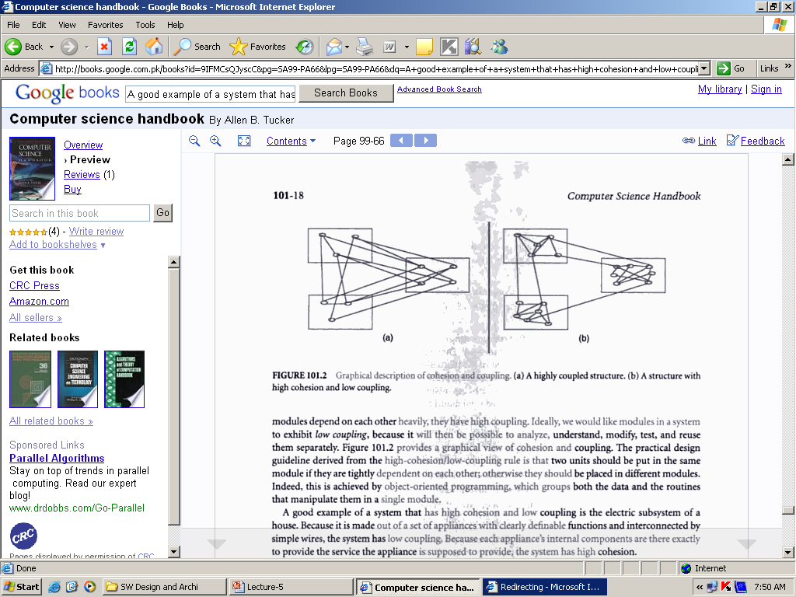
A Practical Example

Slide 14
Example
Assume we need to create a Payment instance and associate it with the Sale.
What class should be responsible for this?
By Creator, Register is a candidate.
Register coupled to payment.

Slide 15
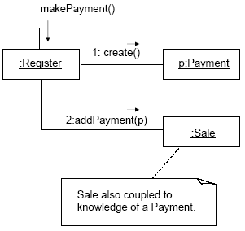

Slide 16
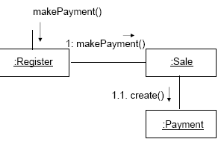
Alternate Solution
An alternative solution is to create Payment and associate it with the Sale.
No coupling between Register and Payment.

Slide 17
There is no specific measurement for coupling, but in general, classes that are generic and simple to reuse have low coupling.
There will always be some coupling among objects, otherwise, there would be no collaboration.

Slide 18
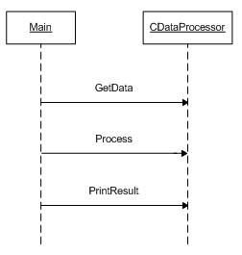
How Low Coupling reduces the impact of change??
CASE STUDY:
Suppose, you’re designing an application that accesses a file in order to get data, processes it, and prints the result to an output file.
For this first solution, the design is ignored and only one class named CDataProcessor is used to:
  Get data from a file.
  Process data.
  Print the result.
And the main method invokes the
methods of this class.
However, this design is exhibiting low
cohesion and high coupling within
one process

Slide 19
Improving Design
Drawback of this solution is that the CDataProcessor class has many responsibilities, so we can’t easily reuse the algorithm in other applications.
High coupling: the processing is high coupled with a console (interface) and also with a data provider.
To improve cohesion, each responsibility must be assigned to a different class, so we need three classes:
  CFileProvider: To get data from a file.
  CDataProcessing: To process data, and this class can use other classes to complete processing, but to simplify the design, we consider that's sufficient for our processing.
  CResultReporting: To report result to a file.
This design will also support low coupling since now the way the data is processed is not ‘highly coupled’ with the process of result reporting

Slide 20
High Cohesion

Slide 21
Cohesion
In software design, a basic quality known as cohesion informally measures how functional the operations of a software element are, and also measures how much work a software element is doing on its own, without depending much on others.
High Cohesion is a desirable property of good design.

Slide 22
High Cohesion Pattern
Name: | High Cohesion
Problem: | How to keep objects focused, understandable, and manageable, and as a side effect, support Low Coupling?
Solution: (advice) | Assign responsibilities so that cohesion remains high. Use this to evaluate alternatives.

Slide 23
Low cohesion – a problem
A class with low cohesion does many unrelated things or does too much work.
Such classes are undesirable; they suffer from the following problems:
  hard to comprehend
  hard to reuse
  hard to maintain
  delicate; constantly affected by change

Slide 24
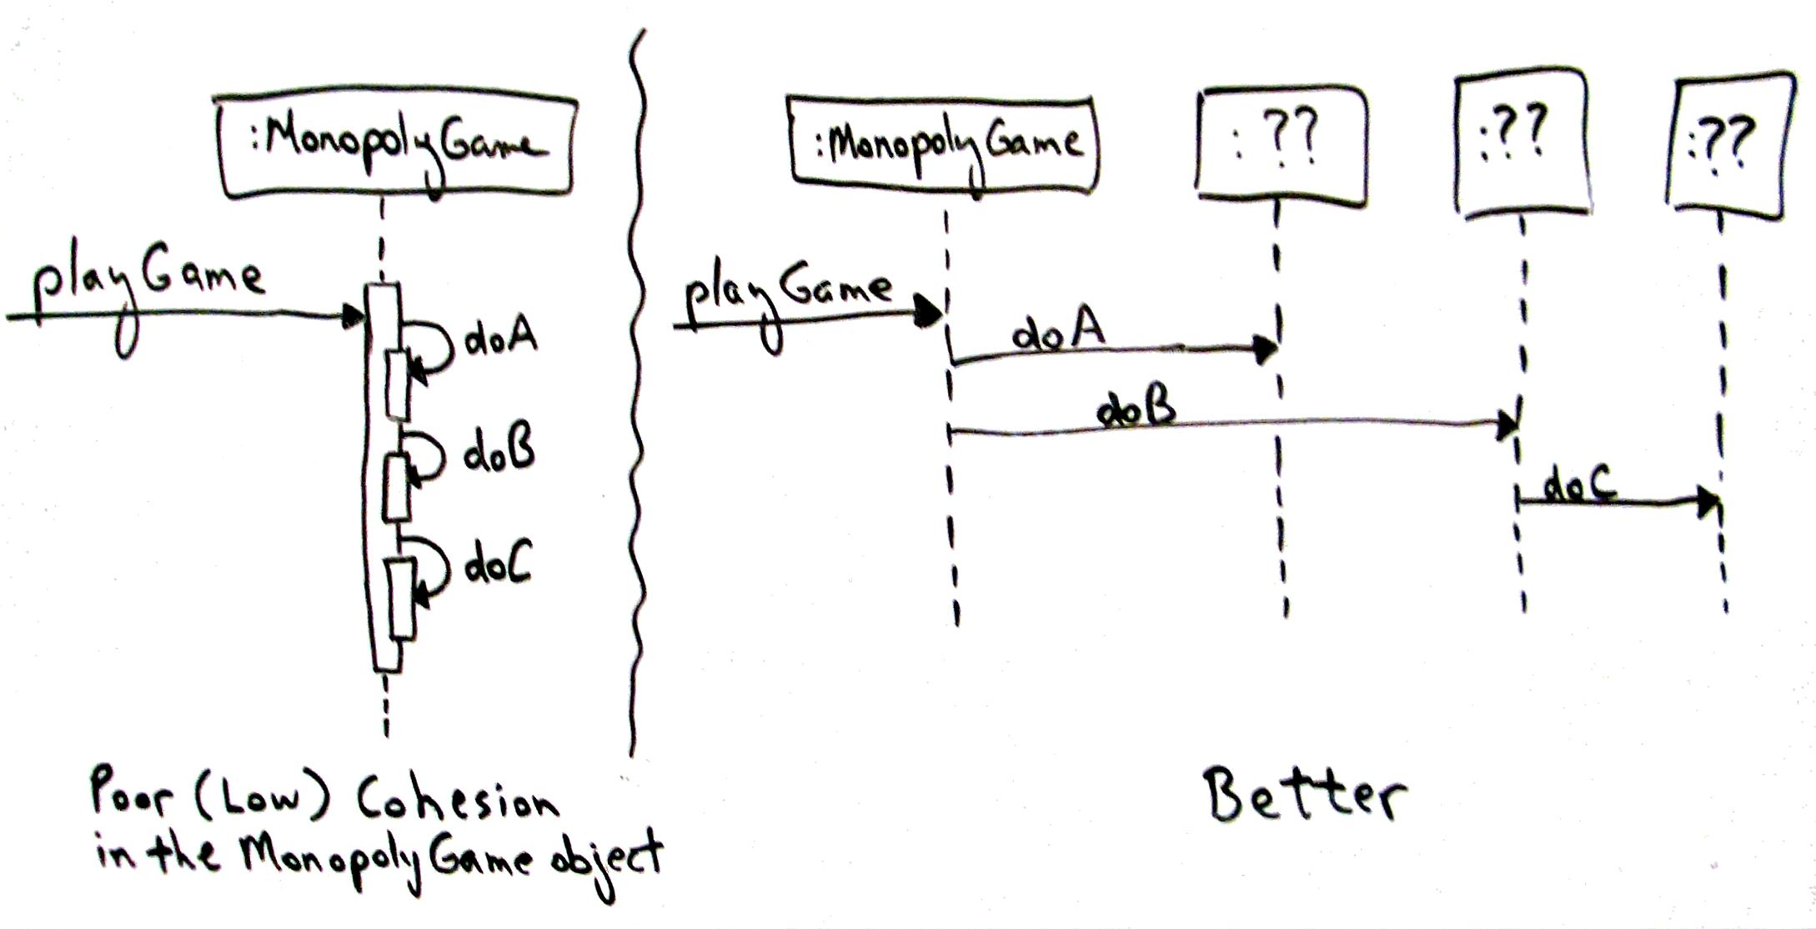
Example – Monopoly Game

Slide 25
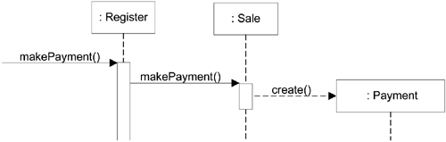
Example

